Slide 1
Macroeconomics

Slide 2
Micro vs. Macro
Simple laws of supply and demand as well as shifters, elasticity, etc. are all examples of microeconomics.
Microeconomics is the study of decisions made by individuals or businesses.
Microeconomics focuses on the effects of single decisions and how they are made.
However, economics also consists of macroeconomics.
Macroeconomics is the field of economics that pertains to large-scale national factors, including government decisions, interest rates, national productivity, and other factors that affect large numbers of individuals and businesses.

Slide 3
Capitalism
The economies of different nations can function in different ways depending on the economic system present in that country.
In pure capitalism, individuals own the resources and have the right to use their time and resources in any way they choose.
Pure capitalism is self-regulating, with only market prices determining the value of goods and services.
The desire for profits motivates economic players to make good trades where both sides benefit from the trade.
Competition and individual benefit are the driving forces of capitalism.

Slide 4
Socialism & Communism
Socialism is where the public owns all private resources and there is no private ownership.
The government or a public entity directs all decisions in the economy and determines who is employed where, what products are made, and how much those products are sold for.
The public can have a say in how those resources are managed; democracy and socialism can go hand in hand in some circumstances.
There are little or no profits or economic incentives, and the production of goods and services in socialism tends to be inefficient because there is no incentive or bonus for producing a superior good,
The outcome is the same regardless of input (unlike capitalism where only the best products and goods are bought and sold).
Communism is an extreme form of socialism where the government has complete control over the economy with no input from the citizenry.

Slide 5
Fascism
Fascism is similar to socialism in that the government has complete control, but also is similar to capitalism in that property is owned by individuals.
However, private businesses only receive economic power if they support the central government powers.
Those that oppose the government lose economic control.

Slide 6
Marxism
Marxism is an economic system that believes that the value of a good should not be determined by market forces but instead should be determined by the number of hours required to produce that product.
The more hours required to make a product, the more the individual should receive for that product.
Products that require few hours to produce should receive a lower price regardless of the scarcity of that resource.

Slide 7
Mixed Economies
Mixed economies are those that are comprised of at least two different economic systems.
Mixed economies are quite common throughout the world.
For example, the US has a mix of capitalism and socialism; while much of the US economy is governed by profit or loss, there are socially-owned ventures (such as Amtrak and utilities).
Few in the US have to build their own roads and power plants.
While China is a communist country, there are also private business owners as well.

Slide 8
Macroeconomics
Macroeconomics focuses on how large groups of people, or even how entire nations make economic decisions.
Macroeconomics focuses on how entire economies can be managed to maximize economic output.
The extent to which there should be a relationship between the economy and government control has always been a contentious questions.
Some economic purists have argued that there should minimal or no government interference whatsoever.
Other economists may argue that government regulation and intervention is necessary for an economy to function most effectively.

Slide 9
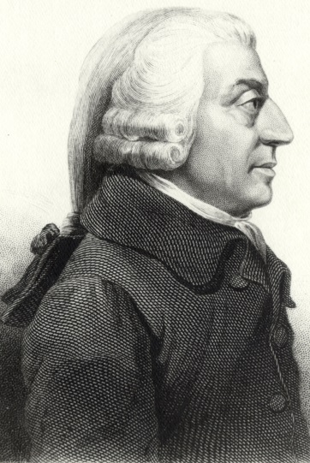
Adam Smith
One of the first to consider the extent to which an economy should be governed was Adam Smith.
Adam Smith is considered the Father of Economics.
Adam Smith established the basis for modern economic thought when he wrote “The Wealth of Nations” in 1776.
In “The Wealth of Nations”, Smith established the theory of Classical Economics.
Classical Economics states that economic freedom should be maximized through laissez-faire economic policies.
Laissez-faire economics = “Let it be” economics
Classical Economics = Laissez-faire economics
Laissez-faire economic policies are policies that have minimal if any interference to the economy through policies such as trade restrictions, taxes, etc.
Source: en.wikipedia.org

Slide 10
Invisible Hand
In “Wealth of Nations”, Adam Smith also coined the “The Invisible Hand Theory”.
This refers to the idea that an “invisible hand” governs supply and demand of goods and services.
The ‘invisible hand’ is each person making decisions based on their own individual self-interest.
According to Smith, self interest is more effective in maximizing economic productivity than any government policy.
Smith believed that the demand of producers to make as much money as possible coupled with the demand of consumers to spend as little as possible would regulate prices and cause them to find an equilibrium.
Smith believed that if a government decided the price instead of the invisible hand of market forces, that this would result in either a shortage or surplus of a good or service.

Slide 11
Risk vs. Output
Smith also believed that the invisible hand of market forces would encourage a producer to invest in the production of only the most-needed goods or services.
Put another way, this means that a business person would only invest in the areas in which there is the greatest need for the production of a good or service due to the risk of the potential of losing their own money on ventures that have less likelihood of succeeding.
This ensures that only wanted goods or services are provided and that the most economic output occurs for the risk of investment.
If it wasn’t the producer’s own investment at risk, they wouldn’t be as concerned if their investment succeeded because it wouldn’t be their own money that they are losing.
Source: www.forbes.com

Slide 12
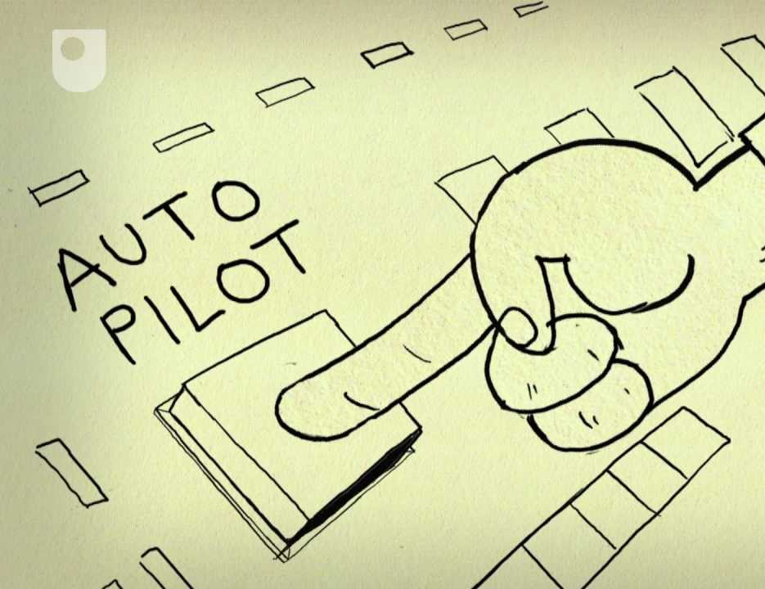
Economics vs. Human Welfare
According to Smith, the best thing a government could do to help an economy is to do nothing at all.
Less government interference = maximized economic output.
Adam Smith’s ideas became the benchmark of economic theory throughout most of the 18th and 19th century.
However, by the 1900s, it was clear that some problems were beginning to arise.
Child labor, excessive hours, unsafe working conditions, and unequal distribution of wealth were widespread throughout the US and the rest of the world.
While Adam Smith’s ideas ensured maximum economic productivity, his ideas did not necessarily result in maximum well-being of individuals in that economy.
Source: http://i1.ytimg.com/vi/ulyVXa-u4wE/maxresdefault.jpg

Slide 13
American Economic Power
Despite the harm that was coming to some groups of Americans, the largely-unbridled businesses of the US in the 1800s and 1900s established the United States as one of the strongest economic superpower in history.
US economic strength and growth resulted from six distinctly-American characteristics:
1) Little or no government intervention or control – the government of the United States originally existed only to keep peace and for national defense with few exceptions.
Source: www.dreamstime.com

Slide 14
American Economic Power
2) Freedom of enterprise- individuals control the factors of supply and demand
3) Freedom of choice and the freedom to fail – the success or failure of a good or service depend on individuals freely choosing what they want and don’t want.
4) The right to own property – you are free to buy whatever you can afford and can control how, when and by whom your property is used
Source: www.dreamstime.com

Slide 15
American Economic Power
5) Profit Incentives – money is spent by businesses with the sole intent to make a profit.
Profits are the sole motivation to spend money to produce goods and services
6) Competition – you will get better service at McDonald’s from a teenager working part time than from a college-educated employee of the government at the DMV making much more money.
This is because the teenager is working in a competitive capitalistic environment where if that business does not perform at its best, it will lose money.
The DMV has no competition and no business to lose – if you want a driver’s license, you have to go to the DMV to get it no matter how great or terrible their service may be.

Slide 16
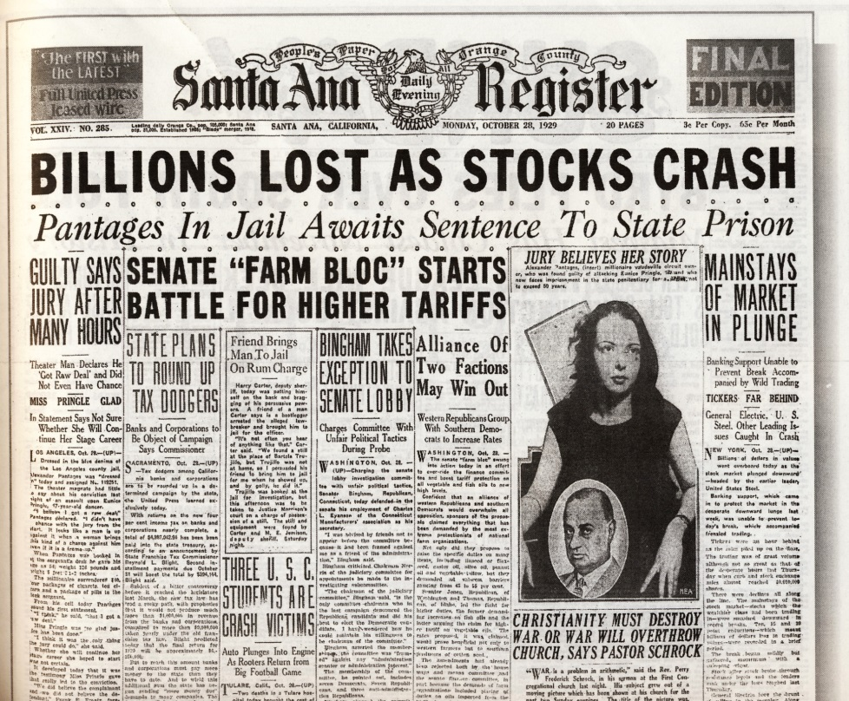
Challenges to Smith
However, generally-accepted ideas about macroeconomics and the US economy were challenged in 1929 by the Great Depression.
President Herbert Hoover refused to interfere with the US economy even during the worst economic disaster in history because of Adam Smith’s Invisible Hand Theory.
However, as economic conditions continued to worsen world-wide, more economists began to question if Smith’s ideas were perfect.
It would take the worst economic depression in history to change how Adam Smith’s ideas were perceived.
Source: blogs.cas.suffolk.edu

Slide 17
Depression or Recession?
A depression is a severe, long-term recession.
A recession is when the Gross Domestic Product (GDP) of a country decreases for two or more quarters (3-month period).
GDP is the measure of the total value of the goods and services produced by a nation’s economy.
If it is July, and the value of the goods produced is and has been less than those produced in December, you have a recession.
A depression is when GDP decreases by 10% or more.
Any GDP decease that is less than 10% over a two-quarter period or more is a recession.
Source: peakoil.com

Slide 18
Depression/Recession
Recessions and Depressions cause economic activity to slow, which reduces the ability of producers to hire individuals to produce goods.
When individuals don’t have jobs, they cannot spend money.
When individuals cannot spend money, demand for goods decreases even more, causing more people to be laid off, causing even more reduction in demand, etc. etc.
Recessions and Depressions increase unemployment.
Unemployment = No. of people looking for a job ÷ No. of people who have a job.
Source: jeffreywhitlock.blogspot.com

Slide 19
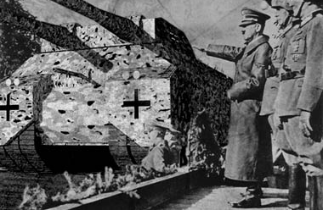
Hitler vs. Smith
The biggest challenge to Adam Smith’s laissez-faire economics came during the Great Depression from two different places.
The first was Adolph Hitler.
Hitler’s Germany suffered economic depression for decades as punishment for Germany’s role in WWI.
Hitler didn’t care about economics – he cared about taking over the world.
By trying to take over the world, Hitler fixed Germany’s economy.
Source: www.unmuseum.org

Slide 20
Hitler’s Economics
Hitler fixed Germany’s economy by spending money that Germany didn’t have to buy tanks that it didn’t need.
By doing this, Hitler put ordinary Germans to work building his war-machine.
When ordinary Germans had jobs, they spent money.
When Germans spent money, the economy grew.
When the economy grew, taxes increased and Germany’s government could pay for the money it borrowed and simultaneously invest in increased economic growth through demand for more military goods.

Slide 21
FDR vs. Smith
The second challenge to Adam Smith came from the country that most-adhered to Smith’s theories – the United States.
President Franklin Roosevelt was elected on the promise to put Americans back to work.
Roosevelt put Americans to work by spending money the US didn’t have to do jobs the US needed, didn’t need, or might need someday.
In other words, Roosevelt created any job possible just to have a reason for the government to pay people.
Public-works projects increased, artists were hired to paint murals in public buildings, crews were hired to restore destroyed habitats, and many other jobs were created that never existed before just to get people back to work.

Slide 22
FDR & Hitler
Both Hitler and Roosevelt fixed their economies by spending money they didn’t have to create jobs that were maybe kind of sort of needed (but probably weren’t vital).
Despite differing motivations, both Hitler and Roosevelt did the same thing – they found any way possible to put the people in their countries back to work.
When people went back to work, they spent money, and the money that was spent created more opportunities to make more money.

Slide 23
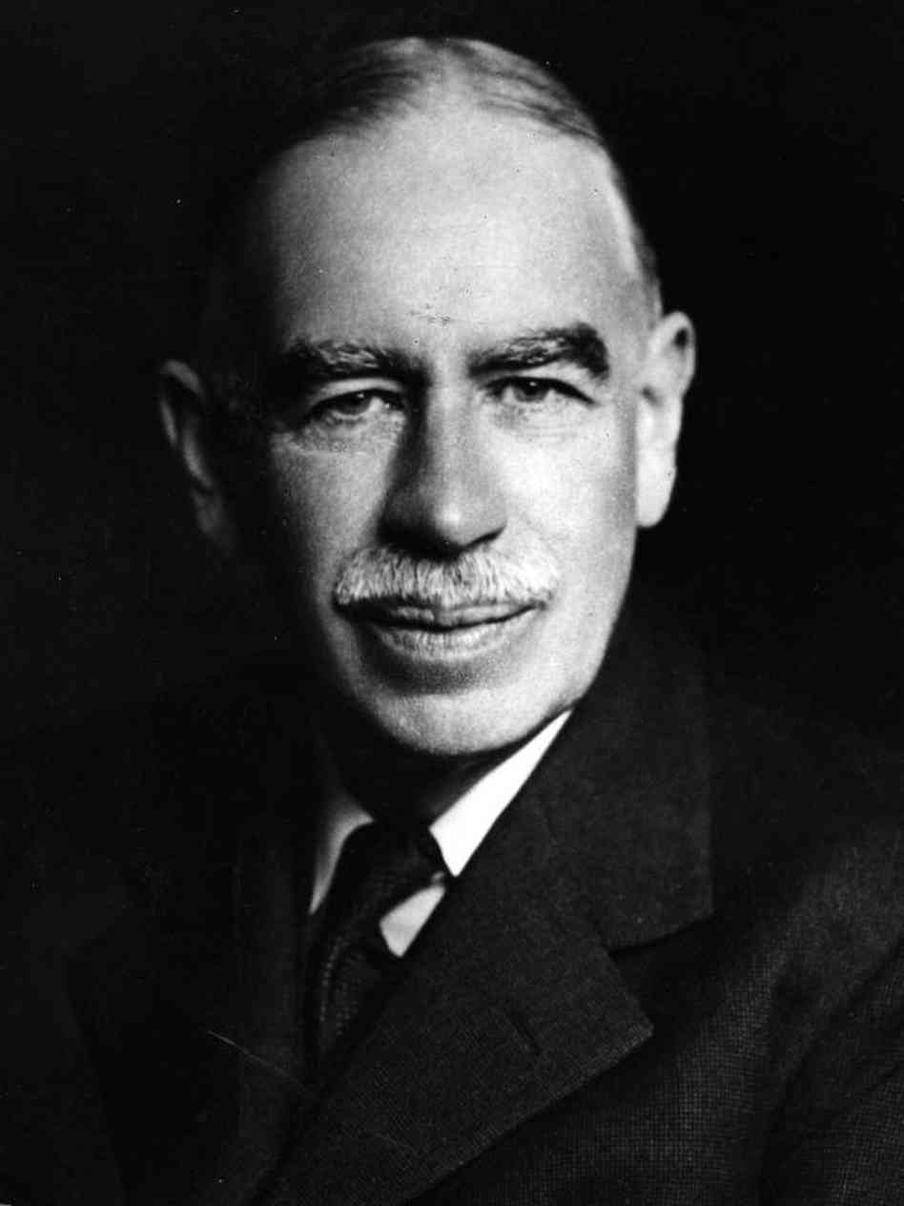
Keynes
During the 1930s, a British economist named John Maynard Keynes attempted to understand the Great Depression and how to fix it.
Keynes saw what was happening in Germany and the US and came to the conclusion that the best way to fix a depression was to increase government spending and reduce taxes to stimulate aggregate demand and pull the economy out of the depression,.
Aggregate demand is a measure of all of the demand that occurs in a country’s economy.
When demand increases, sales and economic activity increase as well.
Source: www.npr.org

Slide 24
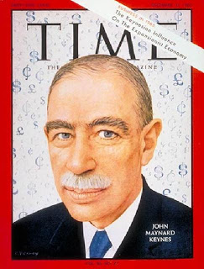
Keynes
Keynes knew that government revenues would be lowest during a depression when the tax base of a country is lowest.
Keynes believed that any debt incurred by a government during a recession or depression would be repaid once the economy was ‘fixed’ by government spending.
Once an economic depression was over, a government could increase taxes and reduce spending to repay that debt.
Failure of a government to spend money during a depression would lengthen the depression and increase the difficulty of fixing the economy.
Source: adanesmit.blogspot.com

Slide 25
The Gold Standard
Keynes’ challenge to Smith’s theory of laissez-faire economics was not the only change to macroeconomic policies.
One of the most wide-ranging changes was how government’s regulated the value of their money.
Prior to 1914, the economies of the world operated on the Gold Standard.
The Gold Standard used the price of gold to determine the value of a country’s currency.
After 1914, the US left the Gold Standard and self-determined the value of its currency.

Slide 26
Strong vs. Weak Dollars
Leaving the Gold Standard was very advantageous to the United States.
If the US wants more ability to buy things from other countries, it can increase the value of its dollar (strong dollar) and buy more goods with fewer dollars.
However, it will also mean that it will cost other countries more money to buy American goods, reducing demand for American products.
If the US wants other countries to buy more American products, it can reduce the value of its dollar (weak dollar).
However, more Americans will be unable to buy foreign goods due to the weakness of the US dollar.

Slide 27
Rampant Currency Devaluation
When the world was in the midst of the Great Depression, each kept devaluing their money to try to increase demand for their country’s products.
When one country lowered the value of its currency, other countries would devalue their currency even more.
Currencies dropped in value so quickly that at times your paycheck was worth less when you got to the bank than it was when you left your job.
The money might be worth even less by the time you left the bank and got to the store to buy your food.
This rampant currency devaluation worsened and lengthened the Great Depression.

Slide 28
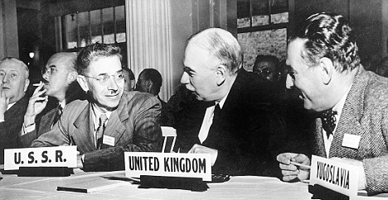
Bretton Woods Conference
In 1944 FDR met with the leaders of 45 other countries in Bretton Woods, NH.
Roosevelt and his economists believed that the benefit of the Gold Standard was that it prevented global currency devaluation, but it also prevented countries from slight adjustments to maximize economic productivity.
Roosevelt’s advisors believed a flexible system similar to the Gold Standard was needed to prevent another Great Depression.
In short, FDR wanted a system that gave the stability of the Gold Standard but the flexibility of not having the Gold Standard.
FDR needed something like gold that had value but something like the US dollar that had flexibility for changing economic conditions.
Source: www.dailymail.co.uk

Slide 29
The US Dollar Reigns Supreme
It was decided at Bretton Woods that the US Dollar would be the standard by which all other country’s money would be valued.
The dollar itself would be convertible into gold, creating both stability from the gold but flexibility in rates from the dollar.
The International Monetary Fund (IMF) was created for international monetary regulation so that that countries could adjust the value of their currency, but only within a limited range.
The IMF also provides reliable sources of lending to developing countries to maximize global economic development.
The Bretton Woods system was eventually replaced in 1971 by the Washington Consensus because of later trade problems.
Today there are multiple ways in which the value of a country’s currency can be determined.
The main point is that a country cannot just decide to devalue their currency – there are regulations to prevent the excessive currency devaluation that helped cause the Great Depression.
Because of these regulations, the world has a more stable currency.

Slide 30
Macroeconomics Today
Today there are three main strategies that the US can use to ensure maximum economic productivity.
US Macroeconomics can be viewed most simply as an ongoing battle to prevent both a recession and inflation.
Inflation is when the prices of goods increases without an increase in demand.
For example, a can of Coke used to cost 5 cents. Today it costs you 50 cents.
A little inflation is normal and ok; it means that the economy is growing.
However, too much inflation is bad because it means that your wages will be able to buy fewer and fewer goods and services than it previously could.

Slide 31
Inflation vs. Recession
A macroeconomist is worried about stimulating economic growth enough to prevent a recession or depression, but not so much that it causes excessive inflation.
A recession is simply when there is too little money available to buy goods and services due to lowered economic activity.
Inflation occurs when individuals have too much money available, meaning that firms can charge more for their goods and services even if demand is constant.
For example, imagine you rubbed a magic lamp and a genie granted you your wish that every gets a million dollars.
If everyone had an extra million in cash, a grocery store will spike the price of their food because they know people can afford it.
Gasoline would jump to $10 per gallon because station owners know that every owner has the cash AND the need for gas.

Slide 32
Recession vs. Inflation
To prevent recessions and excess inflation, the US government has three tools.
Fiscal Policy: the government can change tax rates and public spending to increase or decrease how much money is in the economy.
Monetary Policy: the government can adjust interest rates to change how much money is being spent and how much is being stored away in savings and investments.
Exchange Rate Policy: the value of the dollar can be changed to increase the sale of American goods overseas or to increase the purchase of foreign goods by Americans.

Slide 33
How To End a Recession
To end a recession (or depression) and enable individuals to have access to more money you can do the following:
Fiscal Policy - the government spends more money to create more jobs to increase spending by consumers. Taxes are lowered so that Americans hold on to more of their money.
Monetary Policy – decrease interest rates so that less money is put into savings and investments and more is spent on goods and services.
Exchange Rate Policy – decrease the value of the dollar to increase the number of goods sold overseas.
The more goods sold overseas, the more money that comes into the US economy from foreign countries.

Slide 34
How to Fix Excess Inflation
Excess inflation occurs when Americans have too much access to money. To fix this:
Fiscal Policy - the government spends less money to reduce the flow of money into the economy. Taxes are increased to increase the government’s ability to respond to future recessions.
Monetary Policy – increase interest rates so that more money is put into savings and investments.
Exchange Rate Policy – increase the value of the dollar to increase the flow of money into other countries from the US.
The more goods bought from overseas, the more money that goes out of US economy. This also means that consumers will be able to buy more overseas goods with less money.

Slide 35
The Fed
The US has immense power over global finance through the US Federal Reserve System (or just “The Fed”).
The Fed was created in 1913 as a bank for banks.
When a bank loans money, it may have to get that money from sources other than its own customers. The Fed helps ensure plentiful access to funds for loans and investment.
One of the most important functions of the Fed is to determine interest rates for banks across the US and beyond.
Interest is the money you pay in addition to what you have to pay back to cover what you borrow.
For example, if I loan you $20 and charge an additional $1 for the service of getting you money when you needed it, I charged a 5% interest rate.
The interest rates that the Fed charges other banks helps to determine the interest rates other banks charge their customers.
By lowering or raising their own interest rates, the Fed causes other banks to do the same, changing your incentive for putting your money into savings and investments.

